Slide 1
Sync Study
SyncStudy Team
Instructors:
Dr. Wang, Dr. Qiuyu
Notes:
Dear all, it is my honor to present sync study to you (或者简单些welcome to sync study project)

Slide 2
目录
Background. Pain points. Solution. Implementation. Revenue analysis. Financing plan, budget, return analysis. Team introduction. Conclusion.
Notes:
This presentation consists of background, pain points, solutions, Implementation, revenue analysis, financing plan, budget, return analysis, team introduction, and conclusion.

Slide 3
background
Notes:
Let’s start with background

Slide 4

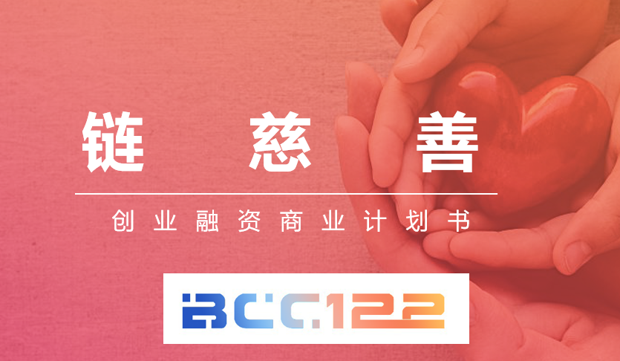


不是链慈善么？
The project iterative process. 1.0 Good Heart Link: XJTLU Blockchain Application Innovation Award. 2.0 chain charity: the introduction of incentive mechanisms to expand the business team, breaking through technical difficulties. 3.0 Sync Study: Start with familiar areas of higher education and solve practical problems around you.
Notes:
This project has iterated from three stages.
Stage one , kind heart link, has owned the top 1 of the XJTLU blockchain application innovation award.
Stage two, chain charity,

Slide 5
From charity to higher education.
Entrepreneurship starts in areas of familiarity: higher education. "The management challenge facing humanity in the 21st century is how to improve the efficiency of knowledge workers and knowledge organizations" ------- Drucker. University education and corporate demand are not closely integrated. Even if you fully learn your knowledge in class, there is a lack of professional industry training during the interview. As myself, as top3 in the CSSE, I still have enough to do so in the face of job interviews with software engineers.

Slide 6
Industry pain points.

Slide 7
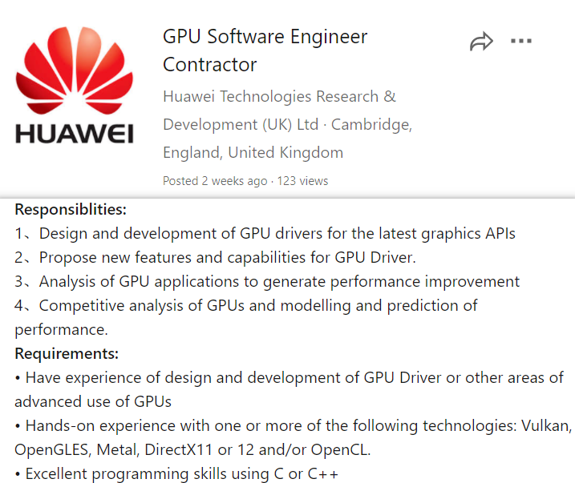

Pain point
GAP
Notes:
students in general education in the university does not fully grasp the full ability of the positions needed by society. There is a gap between the way individuals develop and company needs.

Slide 8


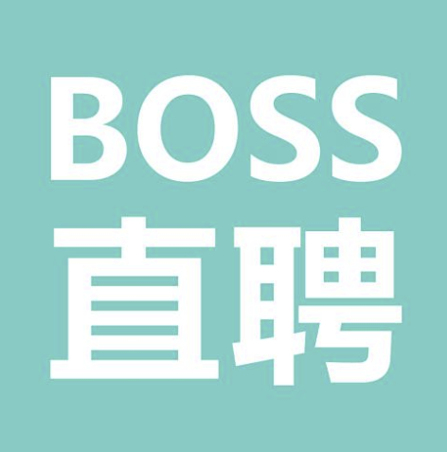


Is there no solution now?
Yes. Lectures, assessments, and coaching at the Career Development Center.
LinkedIn, 58: Job finding APP
However, there are two pain points: The information is fragmented and incomplete. No lectures, no understanding. I've never heard a lecture from a product manager. I don't know how to do it. Even if you hear the relevant lectures,
They do not fit in my development path Assessment APP: from interest to professional. Job search APP: from professional ability to job
We: from major to professional ability.

Slide 9
Solution.

Slide 10
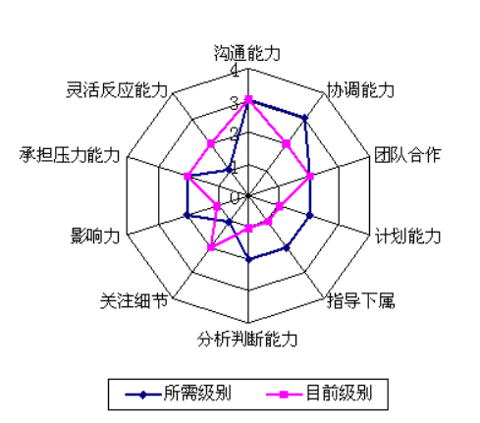
How does your project solve the design?
This is a platform to help students build the ideal personal job-hunting competency model. In this, students will enter their own major, their own hope to engage in the industry, engaged in the company, users will go through a simulation of college life game, and ultimately see if they can meet the needs of this position. After that, the user saw HR provided the post model students according to HR's post model, input their achievements in this area, into the model can identify the factors, system generation in which areas also recommend students to improve their ability, for example, a student feel that they lack research experience, we recommend ILEAD research-oriented learning contest, we can be responsible for the teacher, the group, the form of tweets sent to students. Through a radar map, students can clearly know that I still have those abilities in this field that are worth improving, my own overall development is not uneven.

Slide 11
Then.
After the user has received our recommendation, you can choose to join (click enroll) on this project to learn, in our small program is the status of the project in progress. Student competition, after winning the prize, we open to the research-oriented learning contest teacherproof uploaded interface, students completed a task, obtained the corresponding experience value, in the enterprise or graduate school required radar map more complete and comprehensive. As for the chain information, it is only the result of the model, for example, you have increased the understanding of research ability and organizational coordination ability through research-oriented learning. If the enterprise has the tendency to interview the student, the student can give the enterprise to access the interface, the enterprise should be refreshing, this is the student I want!

Slide 12
Use case diagram.
System boundaries.
The dimension of ability to look for career goals.
See the growth path of the students you want.
HR or. Admissions officer.
College choice game.
学生
see their own capacity gap.
Find points in the school that can improve your abilities.
Collaborate to enhance and demonstrate student competence.
School teacher or. Social practice institutions.
And more strong communication with students to consult.

Slide 13
核心流程图
Team input.
HR input.
Students begin.
HR interviews students.
Model update.
Preliminary job model.
Fix the job model.
Fill in professional, industry, corporate positions.
Upload the credentials.
University simulation game.
Build college simulation games.
Complete the task.
Ability to improve. Module.
再尝试
Select the task.
建模模块
Position competency dimension expectations are presented.
Promotion point recommendations.
现有能力维度对比

Slide 14
Sounds like a LinkedIn, what's the advantage?
Sync Study
LinkedIn
Based on the actual, service Xipu students. Career planning and growth platform. Personalize the ability to help students discover, understand and compensate for career development. Integrate the school industrial enterprises customized training and Taicang fusion training model, and Xipu 2.0 construction to grow together!
Globalization. Professional social platform. Smart to see other people's tall resumes, lack of clear career path.

Slide 15

Chaining is as interesting as a game.
Like individual setypes of games to stimulate student interest. Experiential role-playing game design, interactive and feedback gaming experience enhances the sense of incoming! According to the wishes of students can be introduced to the common growth mechanism of students, mutual promotion, growth together. Promote better growth in the form of a task upgrade that students love! Start a new, experience all rely on learning! Instead of raising frogs, it is better to develop a better self!

Slide 16
How do you embody artificial intelligence?
Mainly modeling, the source is two. First, topology analysis: fuzzy comprehensive evaluation of the individual's ability to model, build the ability of the topological structure map (mainly for enterprise positions with clear needs). Second, machine learning analysis: use a sufficient number of previously accepted student portraits, do clustering analysis, machine learning, to find the characteristic values of the decision admission (after we collect enough multi-dimensional labels to design a feedback system, optimize the model).

Slide 17

What are the advantages of this project in college?
First, it helps college students become more aware of the relationship between what they're learning and the abilities they're doing in the future interview process (don't complain that what they're learning is useless). Secondly, as college students, in the process of participating in model construction can further understand the value and impact of their major, the future may be an HR perspective to see their own major, and even among students to communicate and exchange "Hey, do you know what it is to learn our major to become a qualified product manager?" " Further, from the perspective of college student users, can more clearly understand what they need, what they already have, how to further achieve it.

Slide 18
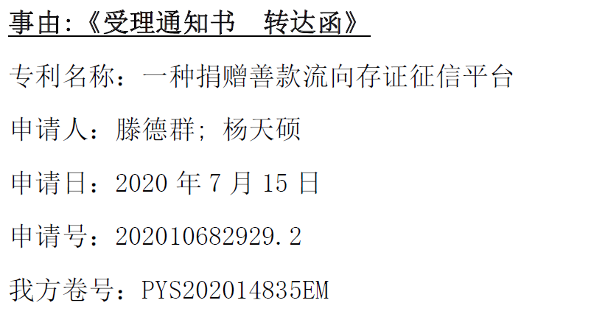
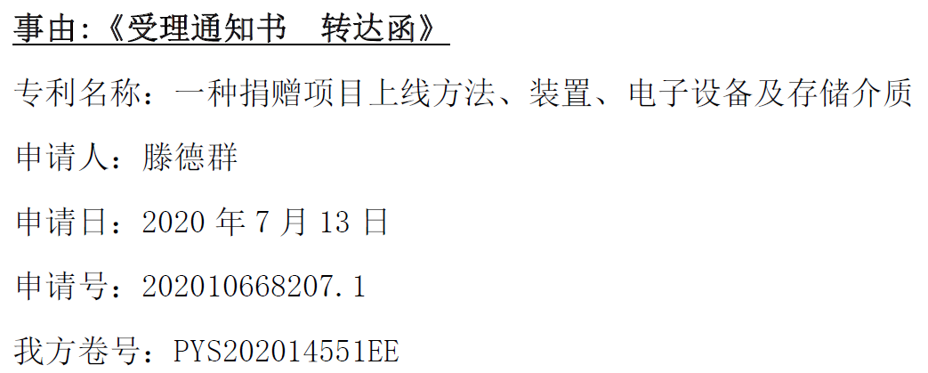
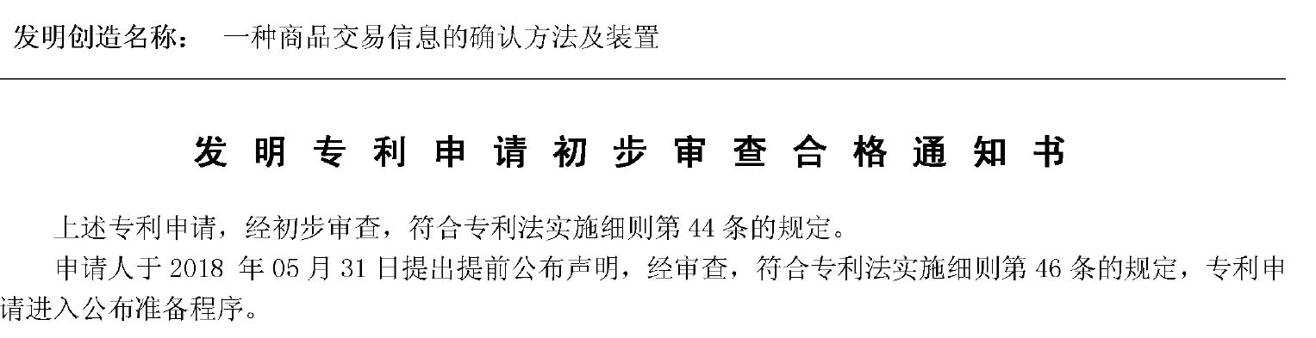
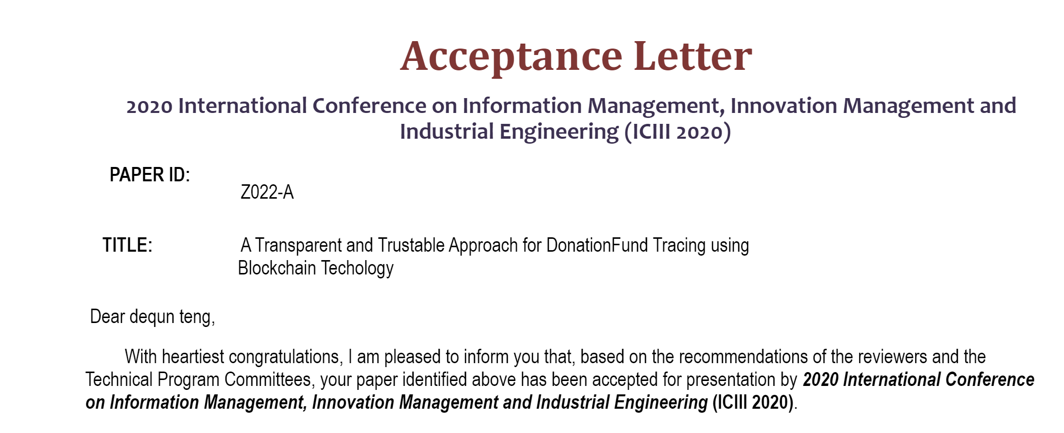
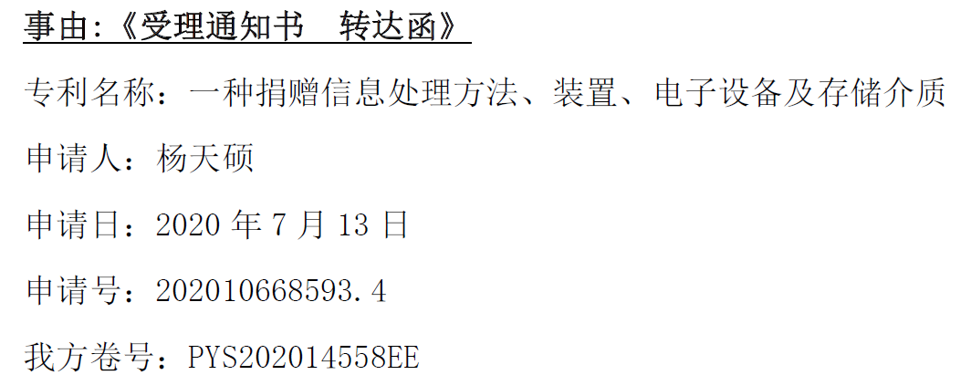
Intellectual property protection.
A technical submission has been submitted. Application has been applied for protection of the right to disclosure. Team members have accumulated 10 patent applications for inventions, 2 substantive examinations, and the rest have received public protection. 2020 Osaka International Information Management. Conference on Innovation Management and Industrial Engineering. (ICIII 2020) for employment.

Slide 19
Technology implementation.

Slide 20

Technology implementation.
Mini program. Two-dimensional code. Choose a major. Career development dimension information. Answer simulation game. Professional competency dimension information. Personal self-assessment (self-assessment and platform review) Gaps in their abilities and goal status.

Slide 21
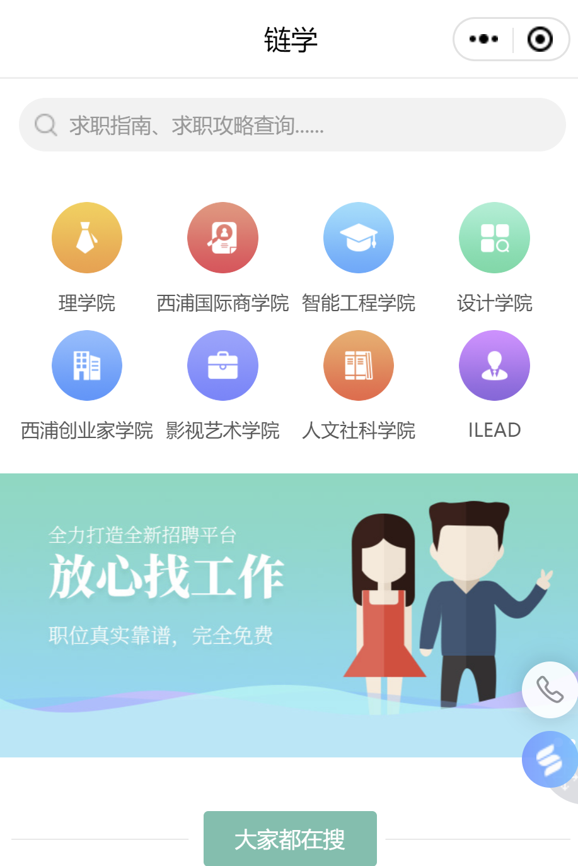
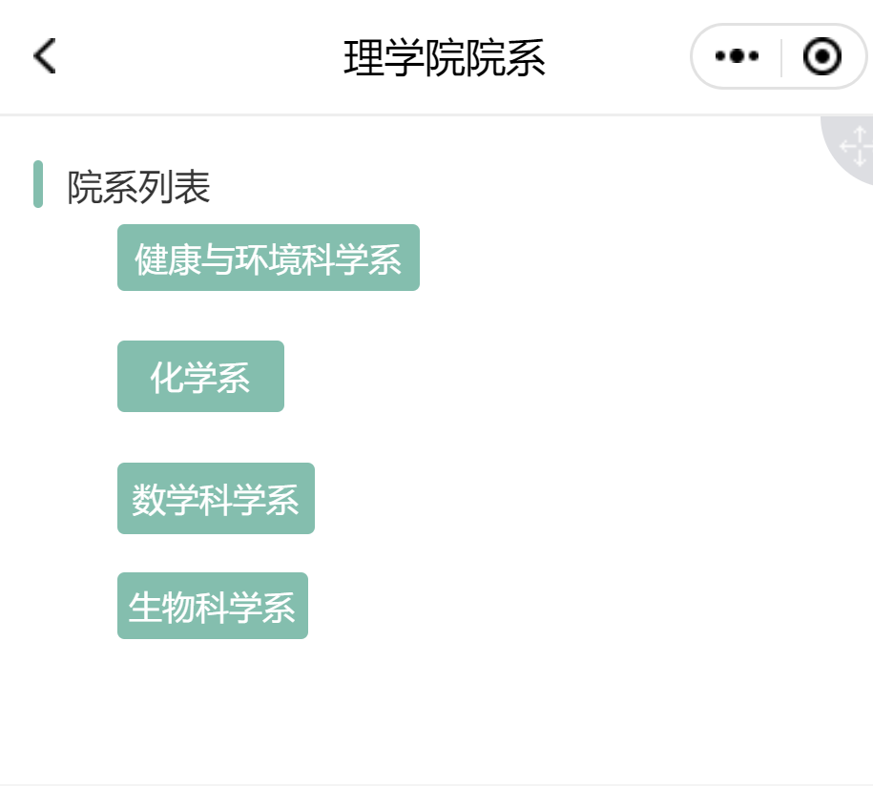
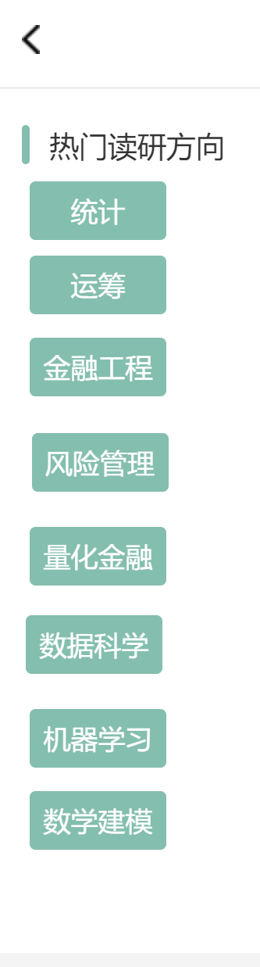
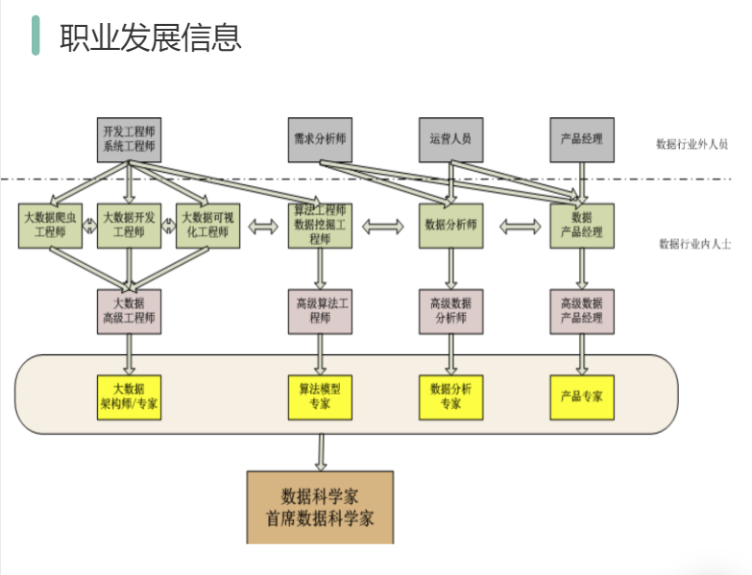
Select a professional-career development message (take the data modeler for example)

Slide 22
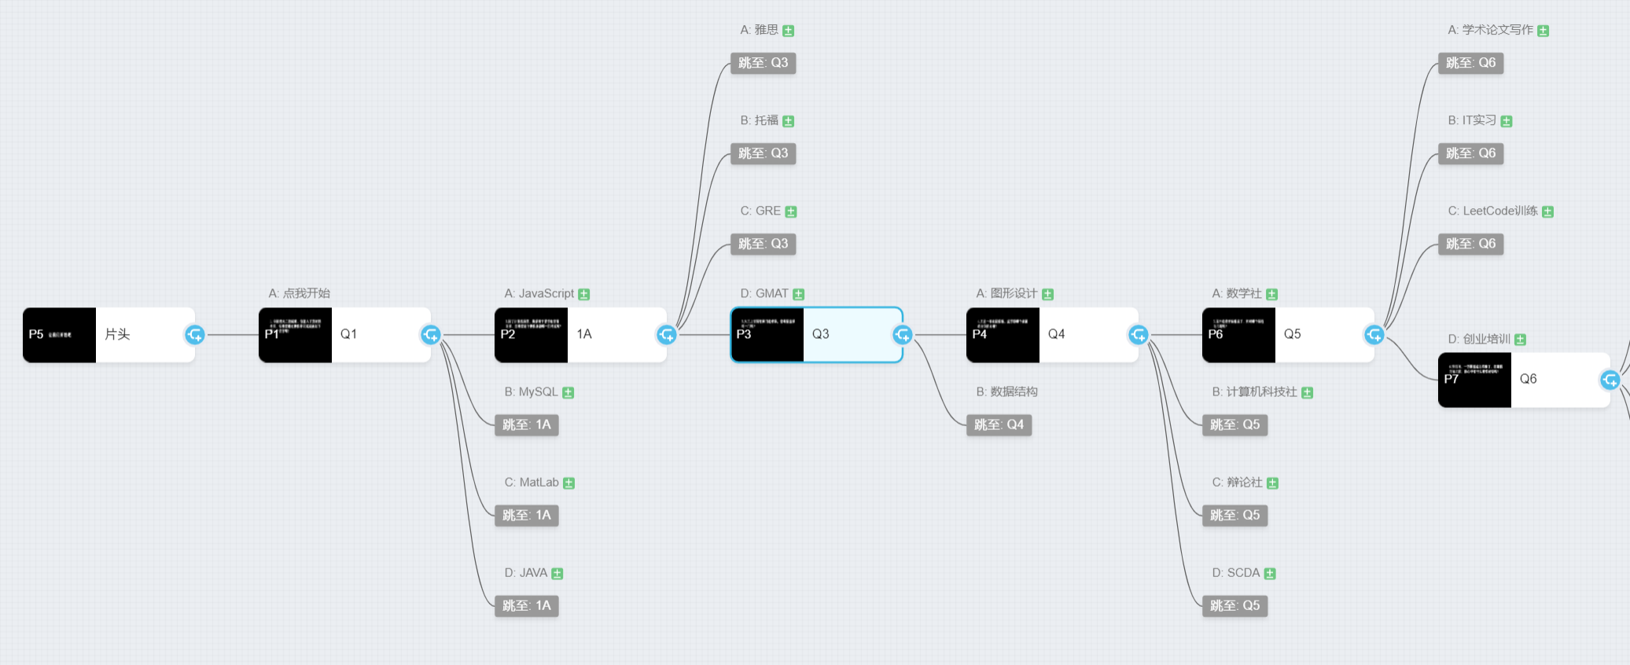

University Simulation

Slide 23
University Simulation

Slide 24

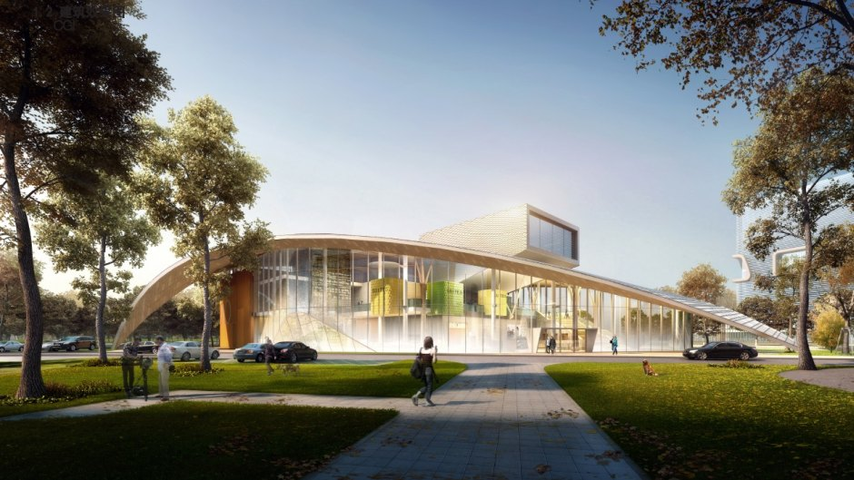
How can you achieve that? Such a huge project
Support from MC @XJTLU
Collaborative Project with SoFTA
Notes:
Firstly, we have got the help from Minecraft @ xjtlu in building the career playing ground. Secondly, quoted from doctor Cheng-Hung Lo, “ Study Sync project is a suitable project for year four digital media art students in their collaborative project in softa department”, possibly leading to more students with directing, screen writing, and painting abilities in joining us project in benefiting their own coursework as well.

Slide 25
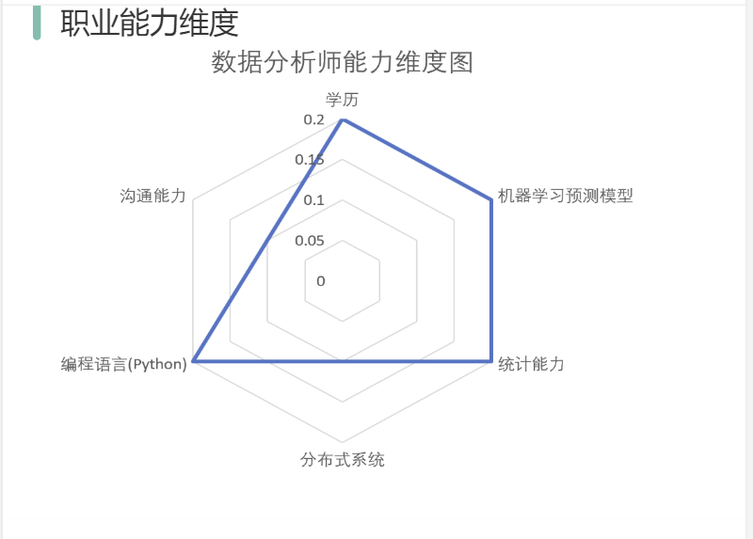
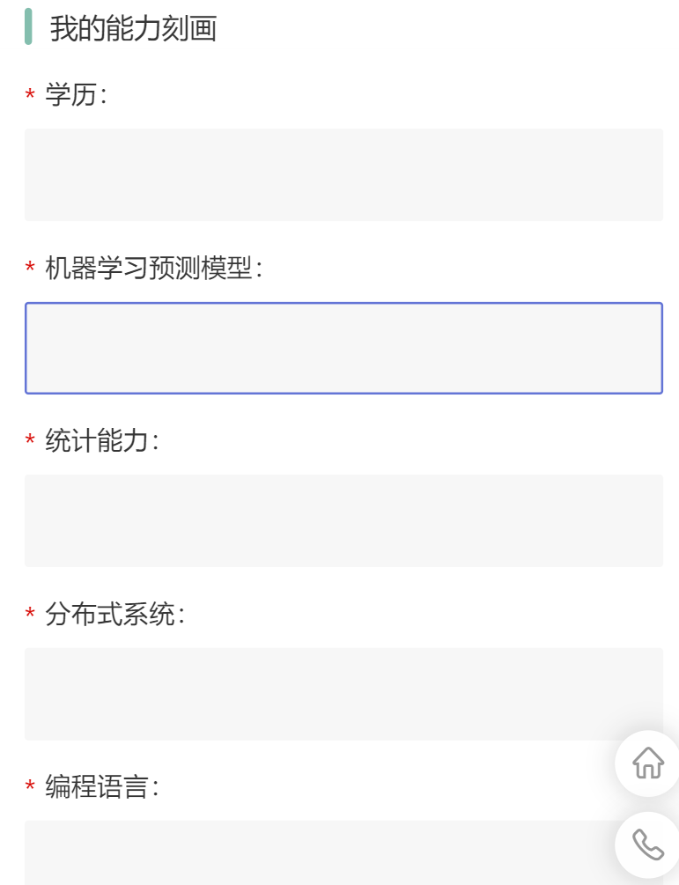
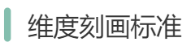
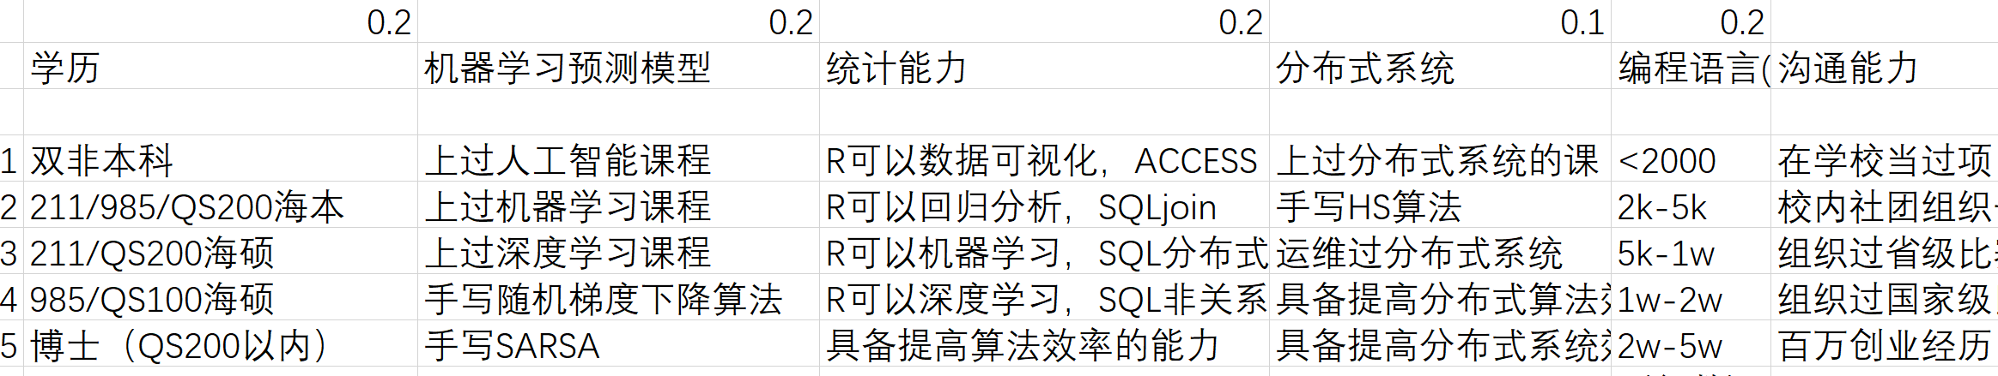
Professional competency dimension information - personal self-assessment.

Slide 26
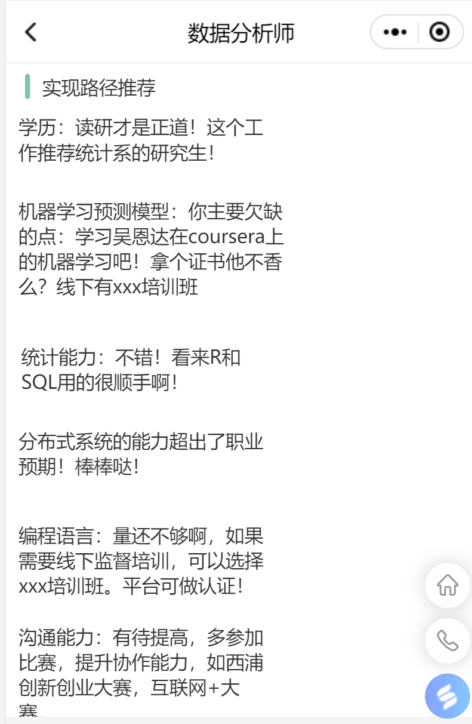
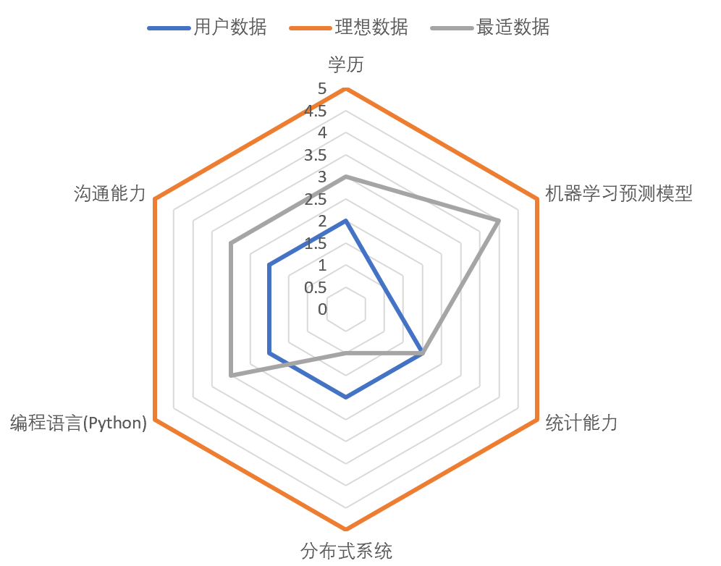
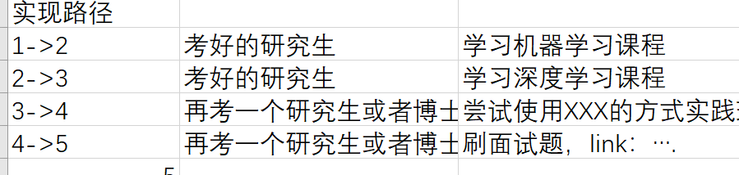
Target radar maps and solutions.

Slide 27
运营收入

Slide 28
盈利模式
Games (online STEAM) Freshman (confusion in selecting a major) Junior high school students, high school students (university choice confusion) Parents who haven't been to college are willing to pay for it. To B: The platform can accept invitations from headhunters, and we can receive VIP top-ups from headhunters and recruitment companies, so that we can send in-house letters to our students inviting (headhunters are looking for students who are more suited to their recruitment requirements). To C: The industry model formed through communication with HR is the ability to provide model references to students other than Sipu for a paid basis. (Students want to be stronger and find better industry models). Through and providing and on-campus learning supermarkets and off-campus learning resources for docking and drainage (educational entities need more customers). Other profit models: advertising, professional HR career counseling, direct educational institutions, support employment office work.

Slide 29
Revenue analysis.

Slide 31
Financing plan, budget, return analysis.

Slide 32
Financing plans.

Slide 33
Financing budget plan.

Slide 34
Financing return analysis.

Slide 35
Team introduction.

Slide 36
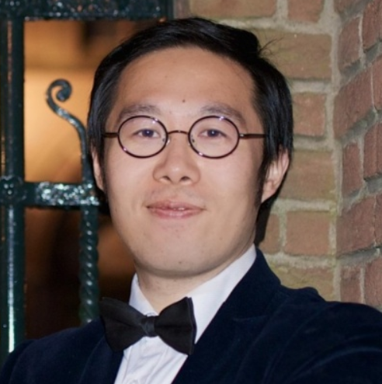
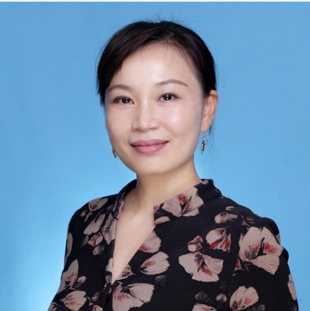
Instructors
Wang Xiao
Qiuyu Chen
University of Groningen, Netherlands. Ph.D., University of Chinese Science. Ph.D. Advisor at IBSS Mentors (Innovation and Entrepreneurship) IIH mentor. Core Researcher, XIPU think tank. Fellow of the British College of Higher Education. Distinguished Teacher, University of Liverpool, West Crossing.
LECTURER IN ECONOMICS AT IBSSS. Shanghai Futures Exchange/ Postdoctoral fellow at Fudan University. Ph.D. in Economics, Zhejiang University. Master of Management, Bachelor of Statistics. Research direction: AI trading and risk management, blockchain, data science, derivatives trading.

Slide 37
Start-up team.
Columbia University Of Education Technology, University of London Innovation And Entrepreneurship Admissions. Founder of a startup with more than 30 people. Three good students in Jiangsu Province, national scholarship, Liverpool admission scholarship, academic excellence scholarship, North American mathematical modeling competition first prize. Genesis World Cup China Division 3rd Prize, pwc Enterprise Innovation CSR National 16, China-U.S. Maker Contest Second Prize. Technical group per capita apply for invention patents 7, with mini program building experience, web page building experience. The story of three students.

Slide 38
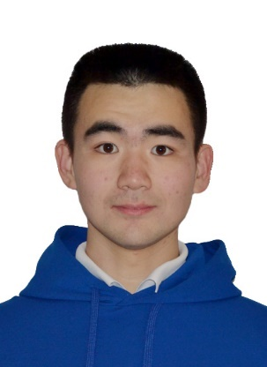
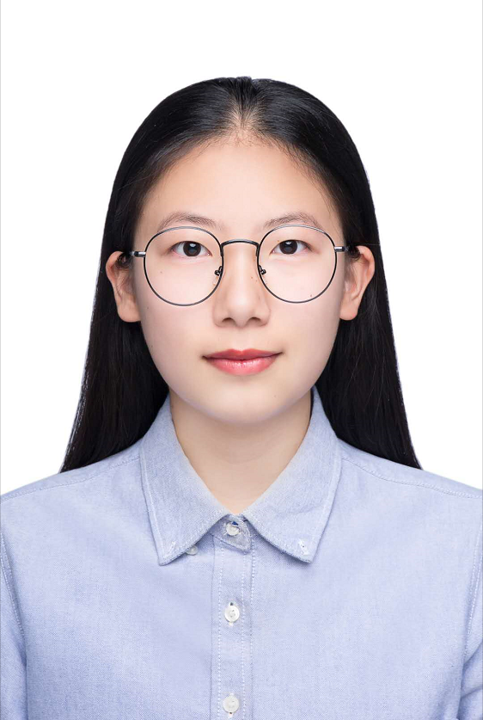
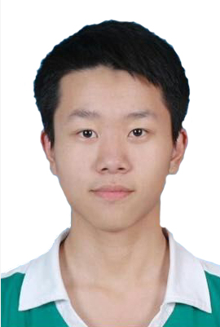
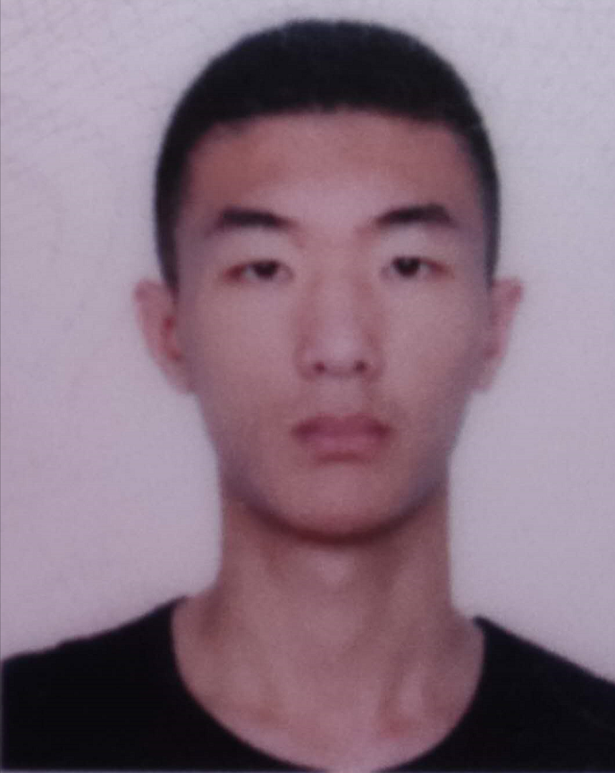
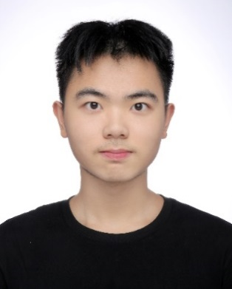
Introduction to team members - Technical Group - Startup Team.
滕德群
张佳
刘俊成
杨天硕
张成锐
技术组负责人
产品组
前端组
后端组
后端组
西交利物浦大学区块链应用创新大赛特等奖，人文科技奖；
链谷杯全国区块链创新大赛，优秀奖（4％）
西交利物浦大学学术卓越奖学金（5%）；
发明专利7项
职能：前端界面设计，use case 图
能力和技术：Java, C++，Adobe Premiere, Photoshop, 前端设计，美工
职能：网站前端设计
能力和技术：Java, C++, Python, Adobe Premiere, Photoshop, 前端设计，写代码，视频剪辑
Java, Python, php，linux，thinkphp，vue,
西交利物浦大学区块链应用创新大赛特等奖，人文科技奖；
链谷杯全国区块链创新大赛，优秀奖（4％）
java, C++, mysql, mongodb, linux, Rust, node.js,
2019 SURF 计算机视觉追踪

Slide 39
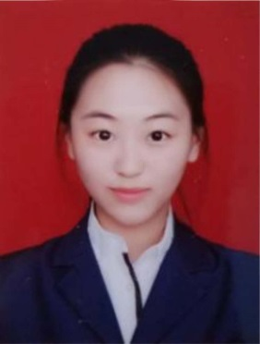
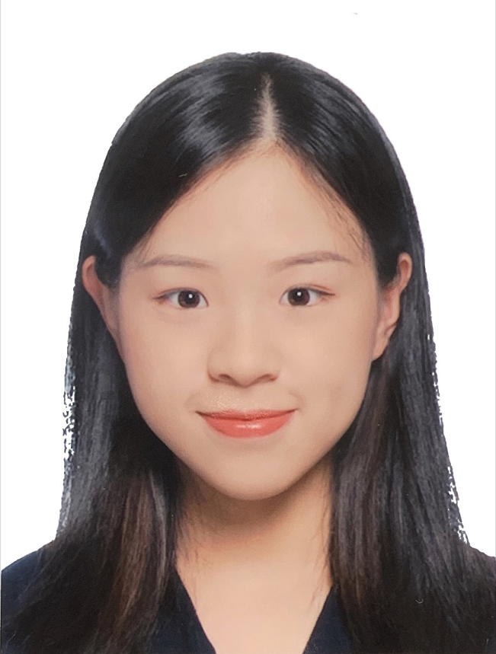
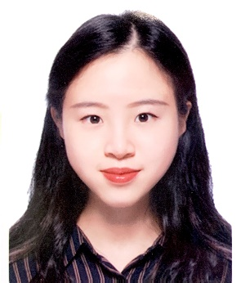
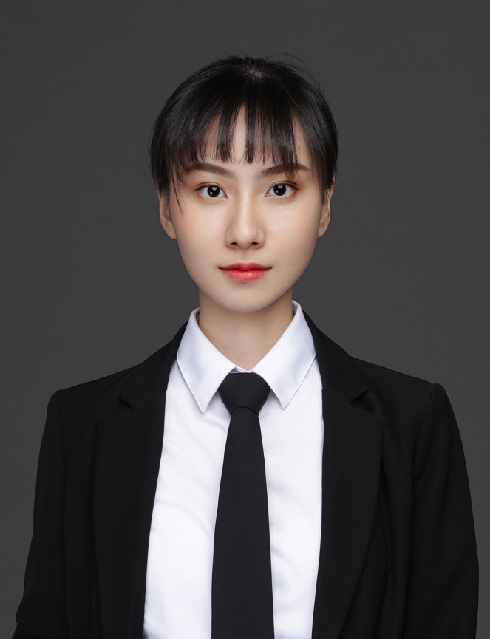
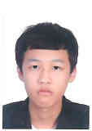
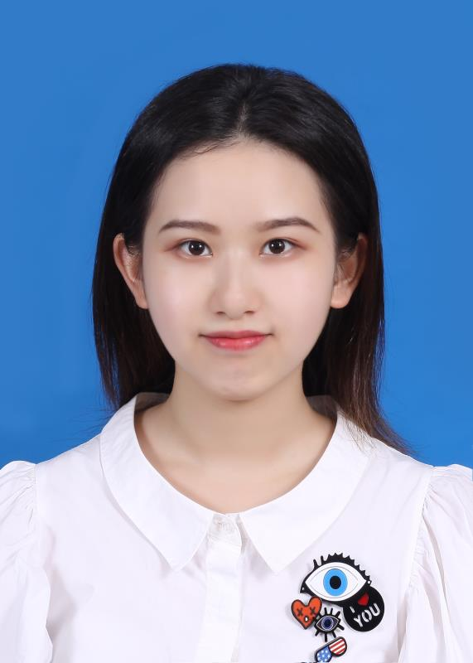
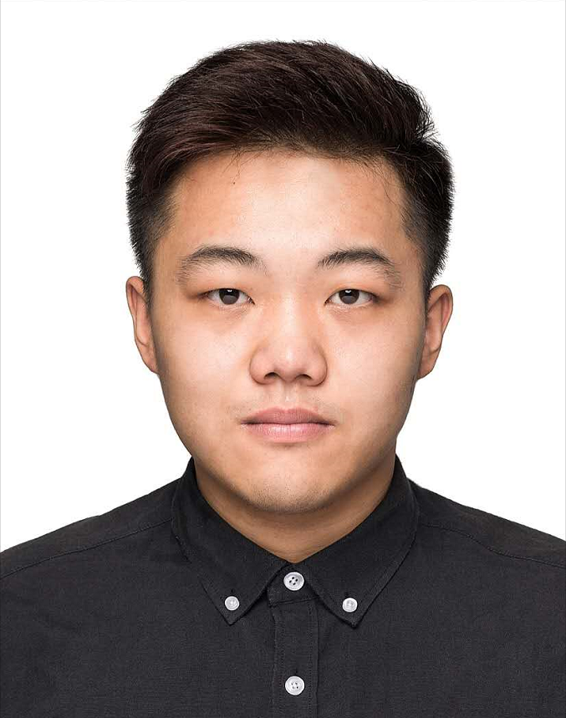
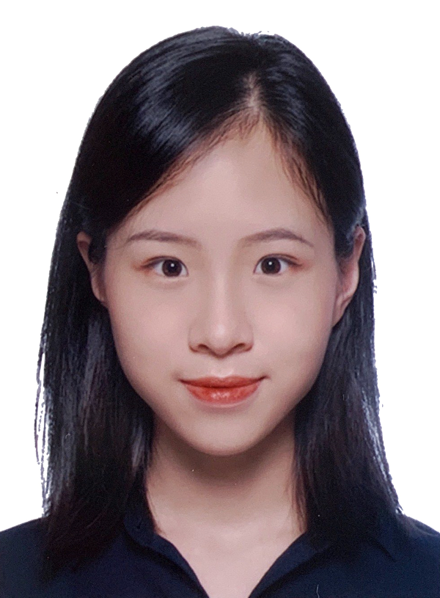
团队成员介绍- 商务组 -创业团队
赵知礼
刘雅婧
吴骅庭
吴骅晏
商务组负责人
创业组
市场组
市场组
连续创业者；具有30人+的公司管理经验，具有优秀的组织协调与管理能力；
创行世界杯中国赛区三等奖
伦敦大学学院 创意创业专业录取
中美创客大赛二等奖；BM商赛第三名；数据分析比赛第二名
精通Google Analytic, SQL, SPSS
行销策划P&G 2020 CEO挑战赛，上海STP种子人才培训项目；西浦优秀学术奖学金（1%)
精通GA, Adobe Photoshop, SPSS；
C3创意职场实战项目第一名，2019年Ｑ1 world cafe 换桌论坛 表现优异奖
张曌璐
丁圣毅
龚奕彰
吴骅真
会计组
会计组
会计组
市场组
哥伦比亚大学 教育科技录取
西交利物浦大学 best performance in FYP
数学建模大赛 M奖 经济学人校园调研大赛 全国第七硅谷全球商业企划大赛 三等奖外研社全国英语大赛 省一等奖ACCA 8门通过； 连续两年校内surf经历
ACCA5门通过；西浦商业慈善社社长；西浦公益委员会主席；
商业模拟大赛创办经历
ACCA过6门通过；PPT设计；Excel Sage； PWC you plus 项目；模拟创业大赛二等奖
精通Adobe Photoshop、SPSS、市场研究、营销计划撰写、创业计划书撰写经验丰富；PPT制作达人

Slide 40
都是在校学生，如何持久投入项目运营？
The independent completion of the venture project as the founder's graduation design, the four-year-old's continuous investment is guaranteed. The partner acts as a corporate entity and has a plan to work and live in Suzhou after graduation. Incentives within the Mission: Participated in the November Internet Plus International Circuit and Xipu Innovation and Entrepreneurship Competition, and achieved phased results. Invention and paper collaboration mechanism: Because most of Xipu students want to apply for graduate school, we produce scientific research results through collaborative papers, patent forms, which are beneficial to students. Your favorite career model mechanism: By modeling students' favorite career models, they stimulate students' intrinsic motivations to participate in the process of modelbuilding. Forms of team external collaboration (distributed model building process): Collaboration with employment office: HR interview form through the Employment Office's workplace network to build a model to assist the Employment Office in counseling. Work with the SCDA (Career Development Association): A way to model collaboration with your target career. And off-campus tutors: communicate in a model manner, and out-of-school mentors identify more specialized students, who build more accurate career models. Project profitability: Course drainage platform. The value of the model itself. Enterprise drainage platform.

Slide 41
Conclusion.

Slide 42



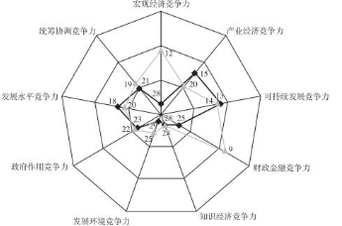

If you were shortlisted, how would you use the fund?
Student evaluation model Mini program development Game Development Server Maintenance Patents and Trademarks Marketing Incubator Renting Maintenance Salary

Slide 43
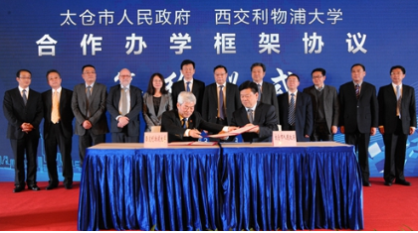
Finally, I want to say.
We firmly believe that Xipu Syntegrative Education concept is more suitable for the development of contemporary college students, Sync Study is willing to contribute a force! Everything is on the way.

Slide 44
We need Angel Funds and Expert judges’ help Thank you
Sync Study Team

